Slide 1



Team 12
E-plant seedling protecting system

Slide 2
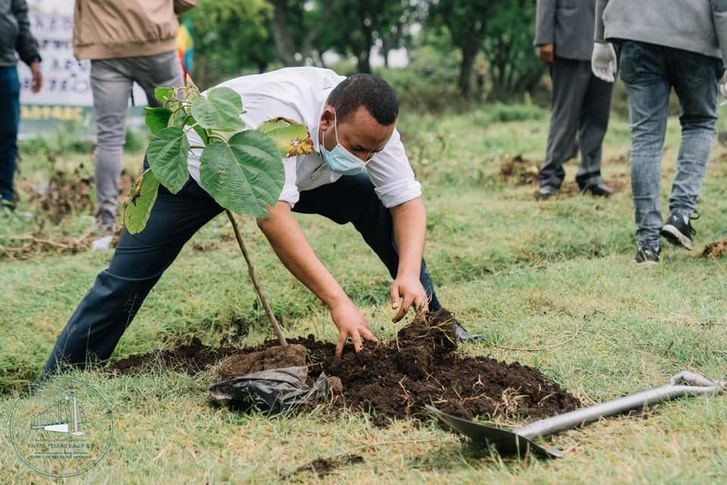
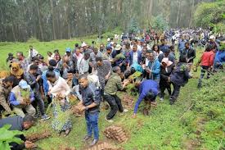
Problem statement
-According to, Ethiopian Enviroment and forest research institute,
Ethiopia has pledged to restore 15 million hectars of land by 2030 under the bonn challenge.
-According to, Green legacy initiative in Ethiopia,
Ethiopia has planned to plant 20 billion plants in the next 4 years.
＃ In this researchs and thoughts, we saw a gap of
lack of encourage of people to take of planted trees.
So, in our project, we tried to fill this gap using web, mobile app(for both android and ios) and telegram bot.

Slide 3
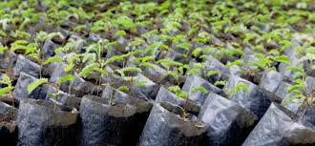
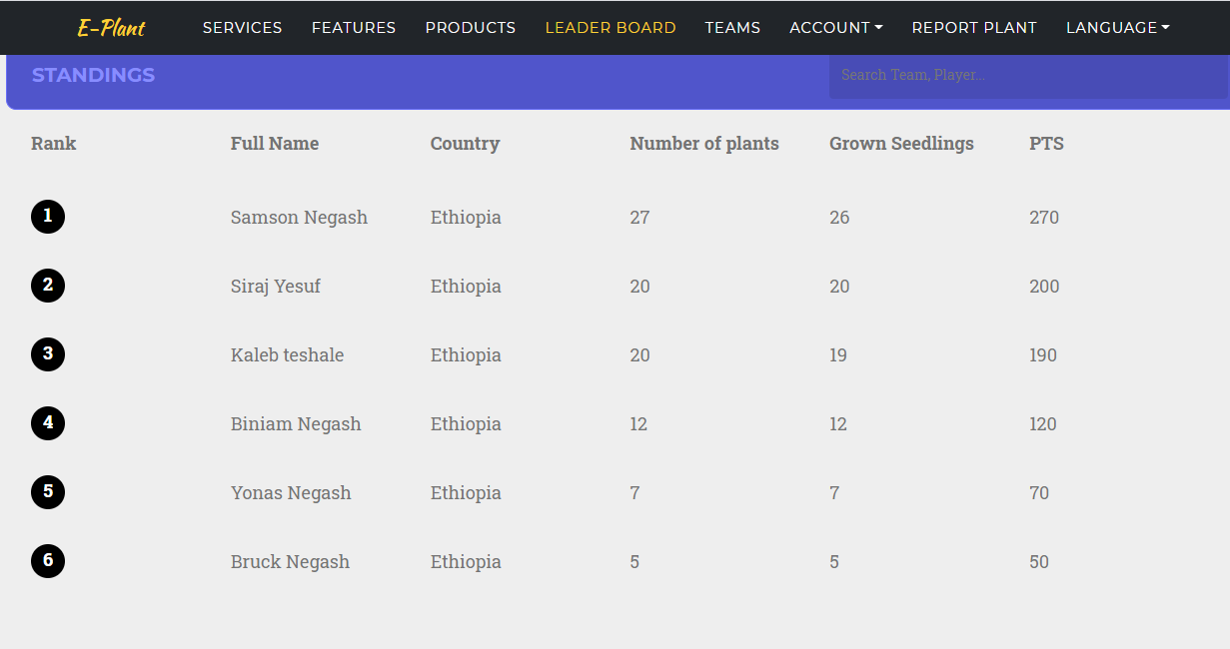
The Solution
-Our website and bot gives information for the planters, where could he/she get the plants that he/she needs.
-It gives a user identity for the planter
-Everybody can give a comment to the planter regarding to his plant using his/her secret number
- The system shows a leaderboard list of top planters, and gives a chance of getting an award and competition.

Slide 4
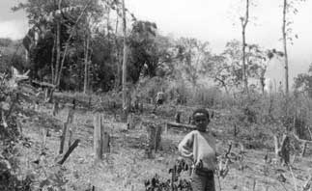

STATSTICS
-According to Study of International FAO, Ethiopian forest coverage downs from 35% to 4.2% with in 9 years.
-A record number of nearly 354 million trees were planted in a single day on what the Government named Green Legacy Day, 29 July 2019

Slide 5
Targeted Users
Demographics
Who are your users?
-any person who needs to participate in his/ her countries development goal
-Age range: No limitation
-Education status: Any person who can have an acsess
phone or website
-language Avalable: It Works on two language (Amharic and English) also there is an apply button which welcomes other language you want
-other

Slide 6

Technology used
Programming language and tools used
For Website: - PHP, Laravel 8,Jetstream
  -Boootstrap,animate.js,wow.js
  -Mysql, 000webhost server
For Mobile App: - Flutter, Dart language
For Telegram Bot: - Python Telegram Bot and wrapper API
For Share An Idea: - GitHut:https://github.com/primeKal/hacktonteam12
-

Slide 7
Team Members
-Samson Negash: flutter and back end of website
-Siraj Yesuf: telegram developer
-Kaleb teshale: Flutter Developer
-Abubeker Shamil: UI/UX Developer

Slide 8
Thanks!
lets move on to the demo

